Slide 1

Basics of Neural Network Programming
Vectorizing Logistic
Regression
deeplearning.ai
Notes:
Lets learn to train pm whole dataset without using a single explicit for loop

Slide 2
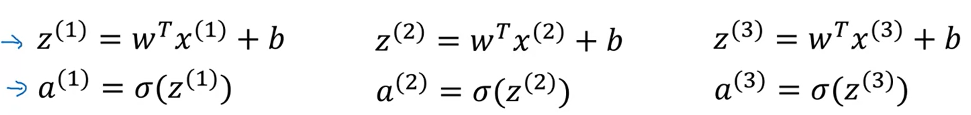
Logistic Regression : Forward Propagation Step -1
Lets say if we have m training examples, than for each example we are doing the following in the forward propagation step:’
It turns out that this process of calculation y hat or a we can do this without using an explicit for loop for m examples.
Remember that X is our training input matrix, in which the examples are stacked in columns. The order of the matrix is such that rows = features & columns = m
Notes:
Lets first examine the forward propagation step.

Slide 3
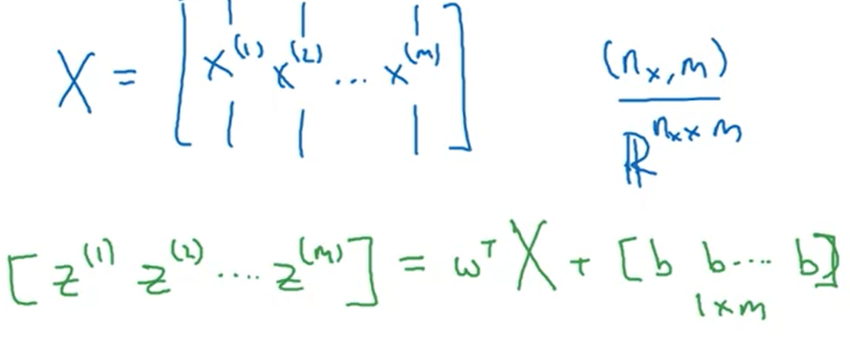
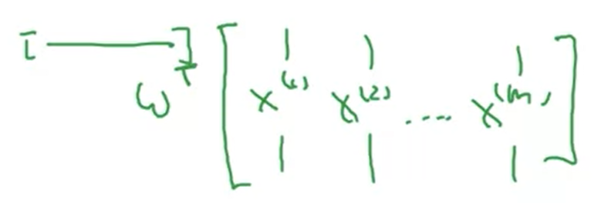
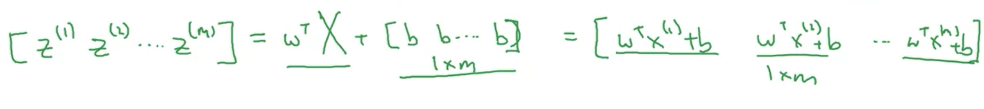
Logistic Regression : Forward Propagation Step -2
First, we will show that how we can compute the z values in just one line of code. The example is shown on the right.
X(Nx, m) & the weight matrix will be (Nx, 1) . When we take transpose it will be (1,Nx) order. [w1,w2,..Wnx]
The resultant matrix will have an order of 1 b m
To this 1 by m vector we add the bias terms.
Each element of this new vector is basically z1, z2,z3..zm that we were trying to calculate in a loop.

Slide 4
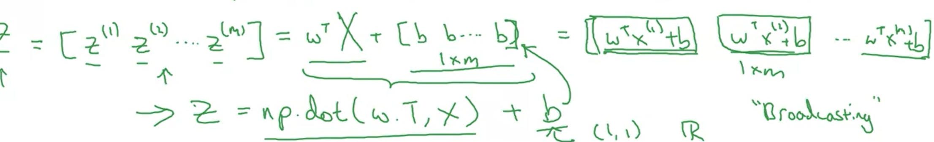
Logistic Regression : Forward Propagation Step -3
Just like we stacked our examples X horizontally , similary here in the z vector we have them stacked horizontally.
We name this as a Big Z, it has order of 1 x m.
To implement this we can use np.dot command in python.
Python has a subtlety, in a sense that when we add B (a real number or (1,1)to the z vector, python broadcasts the b to 1 by m vector on its own.

Slide 5

Logistic Regression : Forward Propagation Step -4
Previously we have use vectorization to compute X & Z by horizontally stacking them & by using matrix multiplication.
Now, in this slide we will try to use the same mechanism to find A the row matrix/vector of a1,a2,…am
We will use a sigmoid function & input

Slide 6
Logistic Regression : Forward Propagation Step -5
No need of looping to compute all the z values, one line code.
One line for lower case a .
This is forward propagation for m examples.
We can also use vectorization for backward propagation.

Slide 7


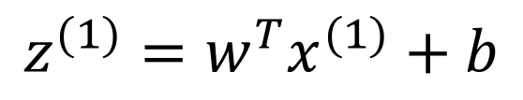
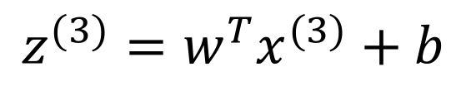
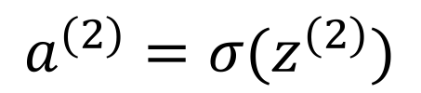
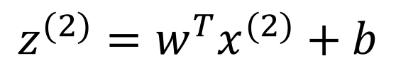
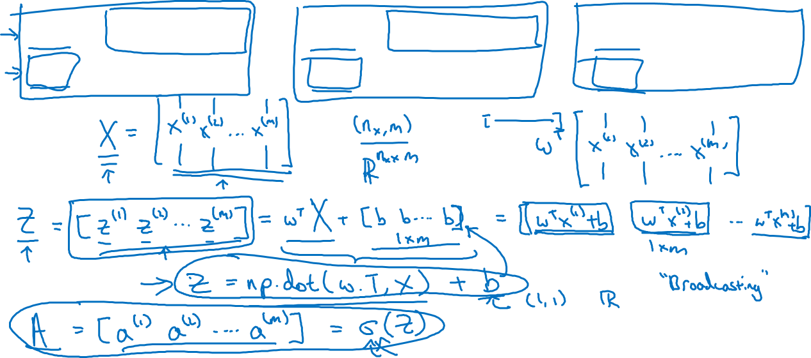
Vectorizing Logistic Regression
$$z^{(1)}=w^{T}x^{(1)}+b$$
$$z^{(2)}=w^{T}x^{(2)}+b$$
$$z^{(3)}=w^{T}x^{(3)}+b$$
$$a^{(1)}={σ(z}^{(1)})$$
$$a^{(2)}={σ(z}^{(2)})$$
$$a^{(3)}={σ(z}^{(3)})$$

Slide 8
Basics of Neural Network Programming
Vectorizing Logistic
Regression’s Gradient
Computation
deeplearning.ai
Notes:
Previously, we have used vectorization to compute predictions i.e. lower case a.
Now, we will use vectorization to compute the gradient descent computations, again without using explicit loops.
We will still need a for loop for the number of iterations.

Slide 9
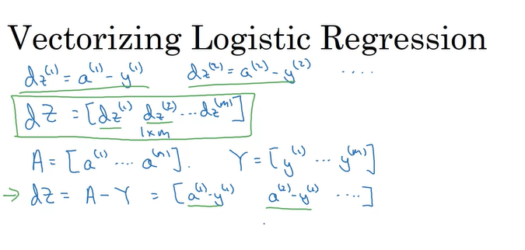
Vectorizing Logistic Regression -1
We computed dz 1 , dz 2 & so on for all m training examples.
We will stack the smaller dz in a similar fashion of 1 b m row vector.
Capital y is a vector of original values of y.
Now dZ will be easily computed In a fashion: A-Y
Notes:
dz is partial derivation of loss function with respect to z.
For each z value we are doing this & instead of doing it in a loop, we can do it using vectorization.

Slide 10
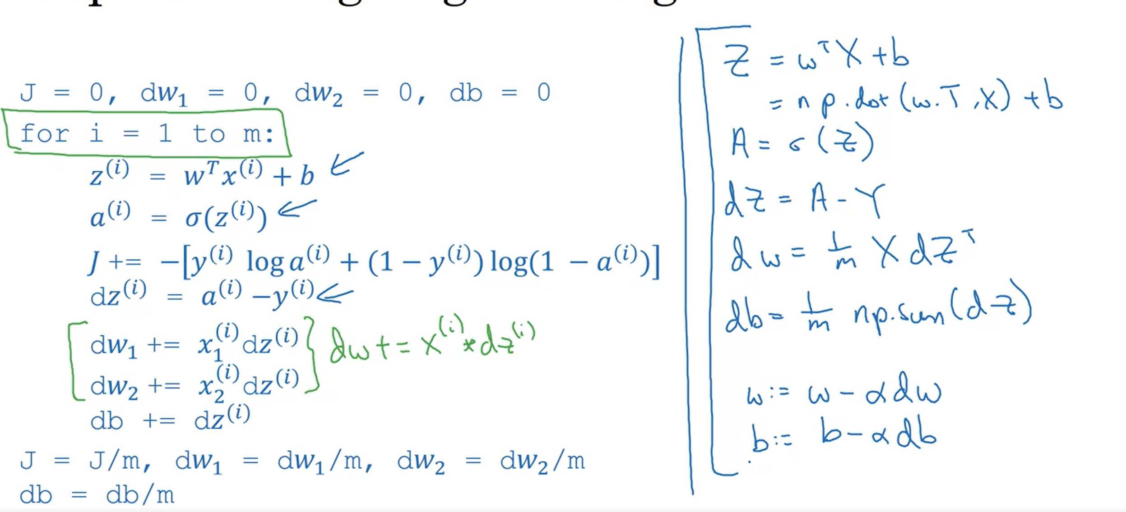
Vectorizing
Notes:
So in each iteration of gradient descent we have weights. After one complete iteration of gradient descent whin includes computing cost over m examples we also need to compute the derivative of cost function wrt to the weights. Now instead of doing it in a form a of a loop we can also do this process as a vectorized operation too.

Slide 11
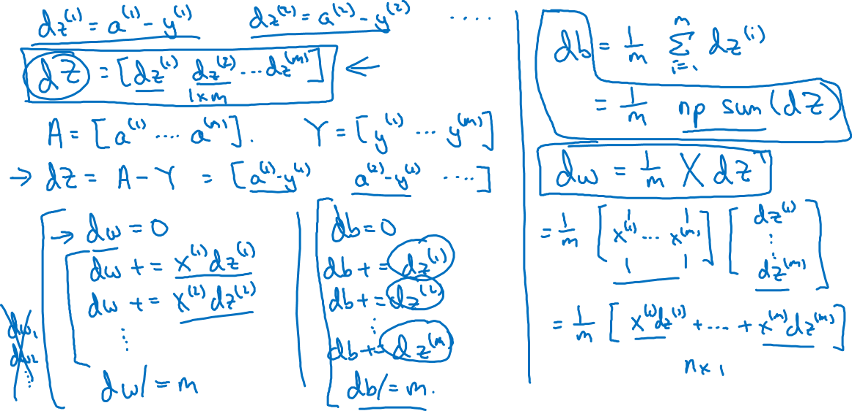
Vectorizing Logistic Regression
Notes:
For each example, we compute z value, than we take sigmoid of this z value to get prediction. After this step, we want to compute the derivative using the prediction & original values.
This can be done in a vectorized fashion as well.
So x has the order Nx * m & the order of dz is 1 * m its transpose order will be m*1 as a result we wll get a matrix of Nx * 1
This is the weight update for each of the w.

Slide 12
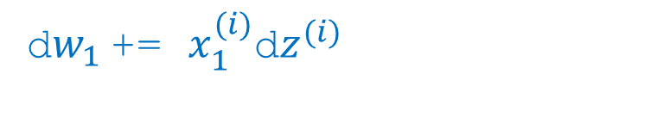
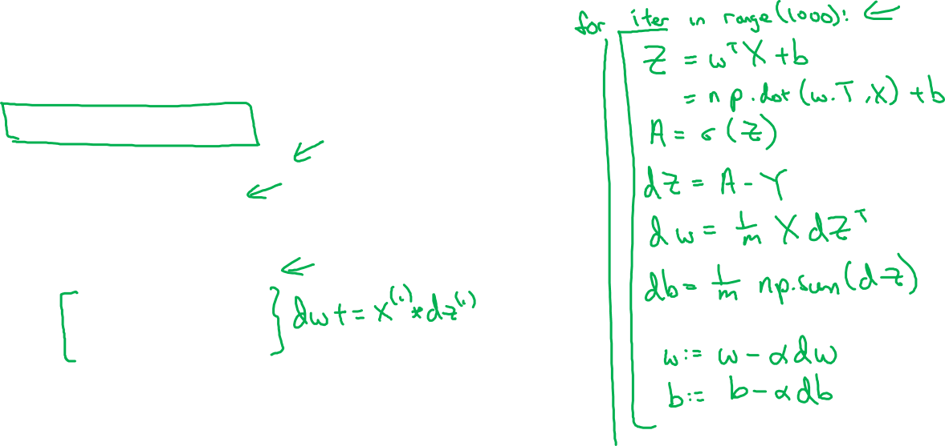
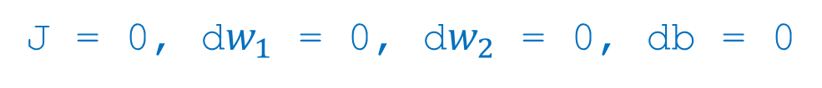
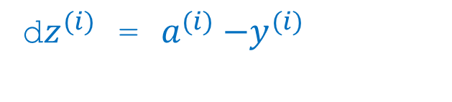
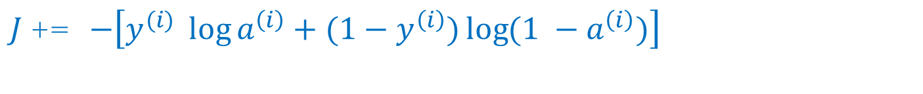
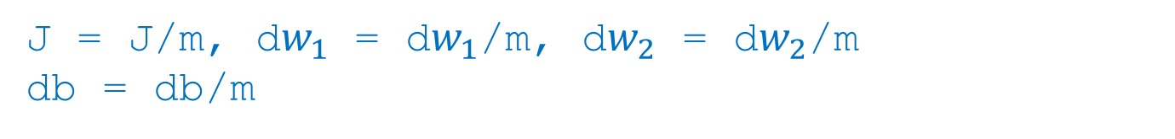
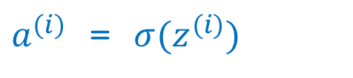

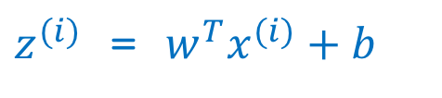
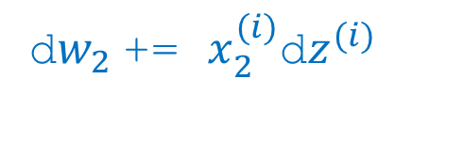
Implementing Logistic Regression
J = 0, d$w_{1}$ = 0, d$w_{2}$ = 0, db = 0
for i = 1 to m:
$z^{(i)}$ = $w^{T}x^{(i)}+b$
$a^{(i)}$ = $σ{(z}^{(i)})$
$J$+= $−\left[y^{(i)} \log{a^{\left(i\right)}+({1−y}^{\left(i\right)})\log{(1 −a^{\left(i\right)})}}\right]$
d$z^{(i)}$ = $a^{(i)}{−y}^{(i)}$
d${w_{1}}^{ }$+= $x_{1}^{(i)}\text{d}z^{(i)}$
d${w_{2}}^{ }$+= $x_{2}^{(i)}\text{d}z^{(i)}$
db += d$z^{(i)}$
J = J/m, d$w_{1}$ = d$w_{1}$/m, d$w_{2}$ = d$w_{2}$/m
db = db/m
Notes:
We have removed the loop of calculating z, a, cost . Also the weight update for loop.

